Slide 1
mINI proJEct II Student management system using python an django
Devendra Singh
University roll no (191599005)

Slide 2
PYtHON
Python is a popular programming language. It was created by Guido van Rossum, and released in 1991.
It is used for:
web development (server-side),
software development,
mathematics,
system scripting.
Python can connect to database systems. It can also read and modify files.
Python can be used to handle big data and perform complex mathematics.
Python latest version is Python 3.4.5.

Slide 3
DjangO
Django is a Python-based web framework which allows you to quickly create web application without all of the installation or dependency problems that you normally will find with other frameworks.
It’s very easy to switch database in Django framework.
It has built-in admin interface which makes easy to work with it.
Django is fully functional framework that requires nothing else.
It has thousands of additional packages available.
It is very scalable.
Django latest version is 2.0.

Slide 4
Introduction of student management system
In this project, I am creating a website based on learning material and it will be a web developers site, with tutorials and references on web development language such as HTML, CSS, JavaScript, PHP, SQL, Python, jQuery, Java, Bootstrap, covering most aspects of web programming.
As many institutions are faced many difficulties to keep details of many students of the organization just in one scratch. It will involve a lot of paper work. Sometime there will be some huge heap of file bundled up and kept together in some corner of the office.
If you want to inform regarding the particular student then it can be obtained by just entering the roll number and name of the student to be searched.
This student management system make the work of storing the data in organising way.
It manage the students details are very easily in one click. Providing the searching facilities such as students, login, profiles, courses etc.

Slide 5
Objective
The main objective of the Student Management System is to manage the details of Profiles, Cources, Logins, Exams, Fees. It manages all the information about Profiles, Student, Fees, Profiles. The project is totally built at administrative end and thus only the administrator is guaranteed the access
The purpose of the project to build an application program to reduce the manual work for managing the students .
It track all the details about the login, profile, courses.

Slide 6
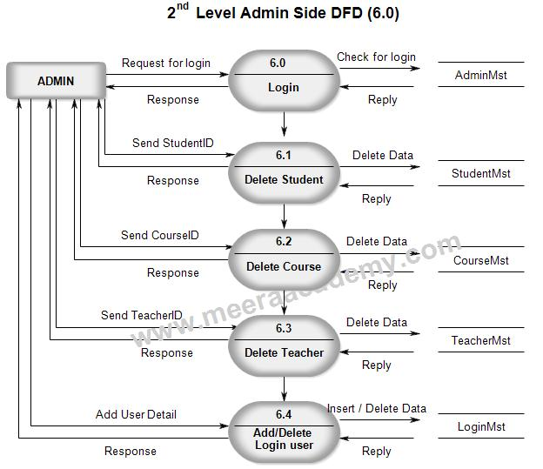
II level DFD

Slide 7
Conclusion of student management system
Student Management System can be used by educational institutions to maintain their student records easily. Achieving this objective is difficult using the manual system as the information is scattered, can be redundant and collecting relevant information may be very time-consuming.
All these problems are solved by this project. This system helps in maintaining the information of pupil of the organization. It can be easily accessed by the manager and kept safe for a long period of time without any changes.

